Slide 1



Using SQL Database Projects
With Visual Studio
SQL Server Data Tools
https://github.com/xhead/SqlSaturdayATL-2024
Mike Diehl, Miked@imaginet.Com
Practice Lead
Data Engineering and Business Intelligence
@xhead
/mikediehlsqlbi

Slide 2


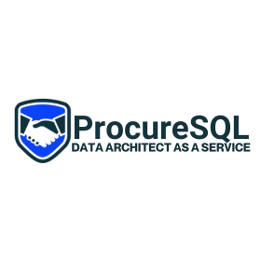






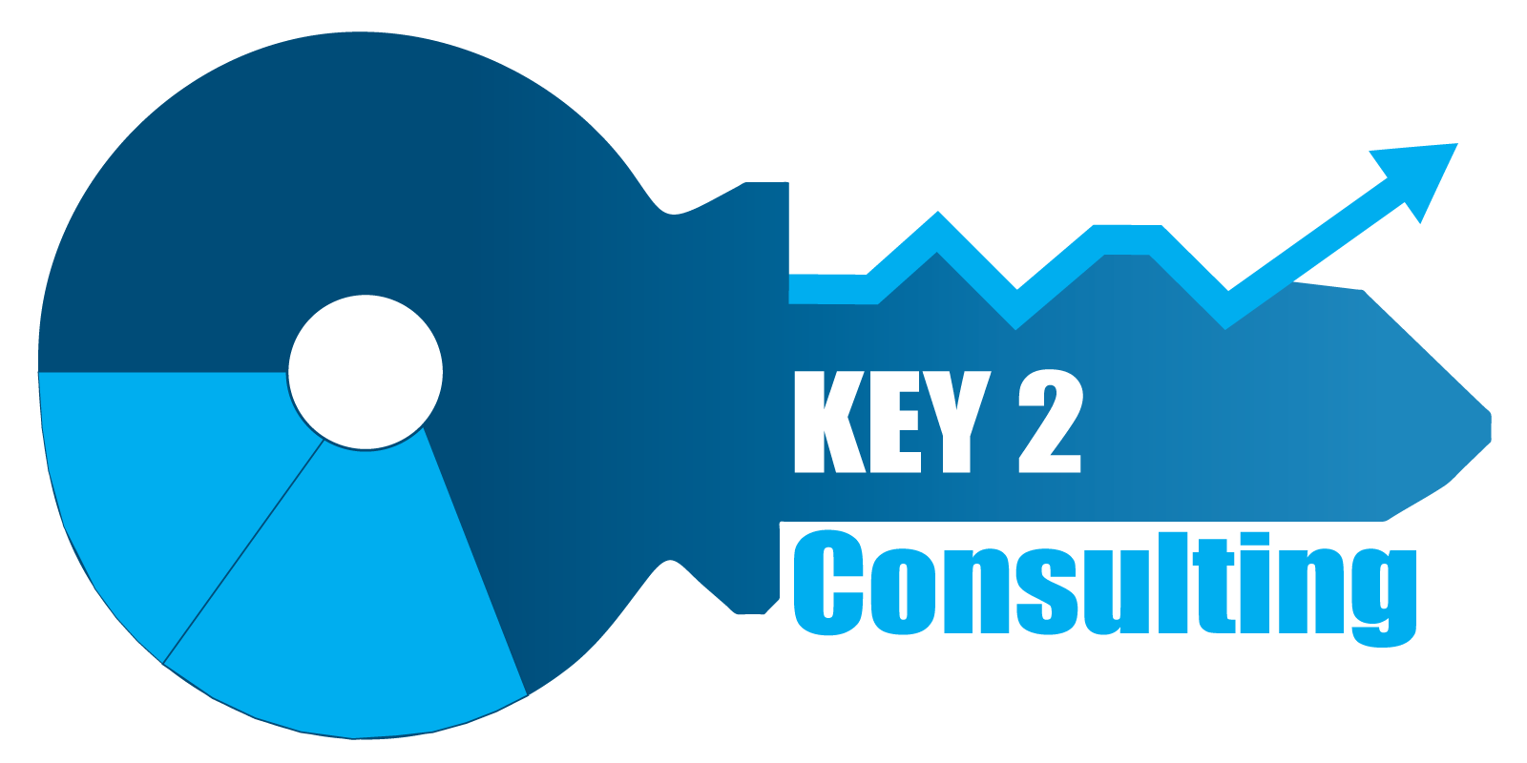





THANK YOU SPONSORS
Please visit our sponsors

Slide 3

ABOUT IMAGINET
25+
Years in Business
Professional services company providing custom software solutions to organizations across North America. Founded in 1997 Located in Dallas, TX and Winnipeg, MB with 100 full-time employees across US & Canada (developers, QA, UX, Cloud Architecture, Microsoft 365, project managers).
20-Time Microsoft Gold Partner Core specialties: Data and Analytics, Power Platform, SharePoint, Teams 10+ years experience with Microsoft 365.
20x
Microsoft Gold Partner
1,400+
Satisfied Customers
3,200+
Successful Engagements

Slide 4
In this session I will show the important features of database projects and the development practices necessary to ensure that your deployments are as fast as possible and retain the existing data that may be present in the target database. I'll show the value of the strong schema checking, refactoring support for object renaming, and how to implement default security, automated data patches, and support for referencing external objects, such as cross-database table references. Finally I'll show how you can use a git repository in Azure DevOps and have code reviews and project compilation checks as part of a check-in operation.

Slide 5


Can you answer these questions?
What did this database look like six months ago?
Can I change the name of a column or table and not break something?
Are there any broken references in this database?
Can I deploy this database to a new database?
Can I reliably upgrade the objects in an existing database?

Slide 6
Database Projects
Visual Studio (Data storage and processing)
SQL files:
CREATE statements
Most files are a single CREATE; table scripts can include CREATE INDEX statements and other; separated by GO
Other scripts
One Pre-Deploy script
One Post-Deploy script
Call other scripts from these two scripts

Slide 7
Desired State Configuration (DSC)
The source code defines the desired end-state.
At deployment, the actions to move from current state to desired state are determined and executed
Migration-based configuration
Each migration specifies actions to move from state to state
From A to B
From B to C

Slide 8
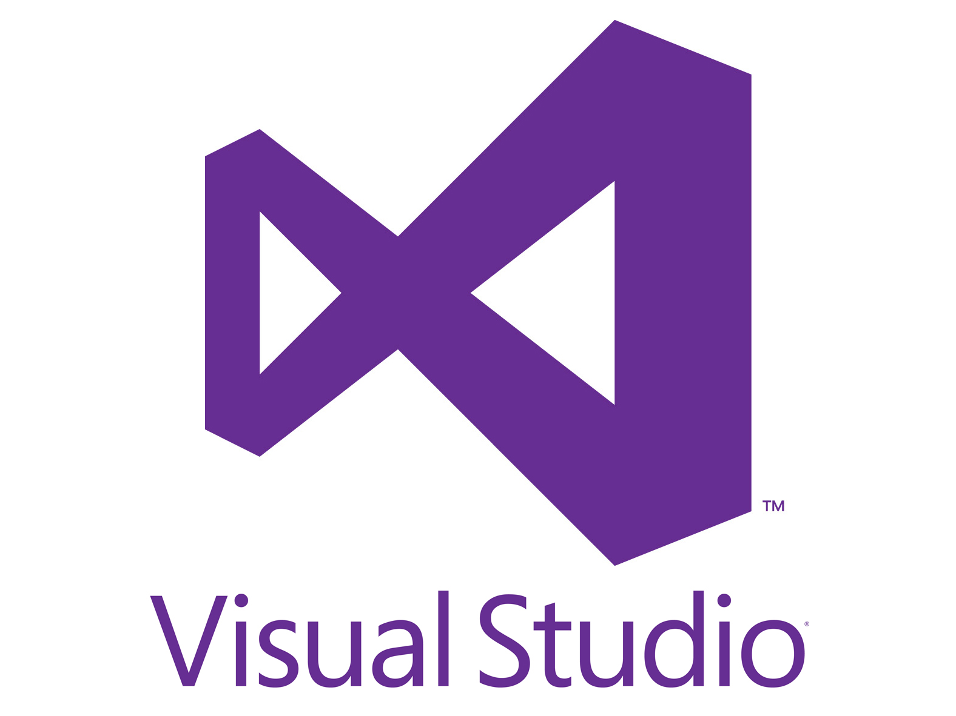
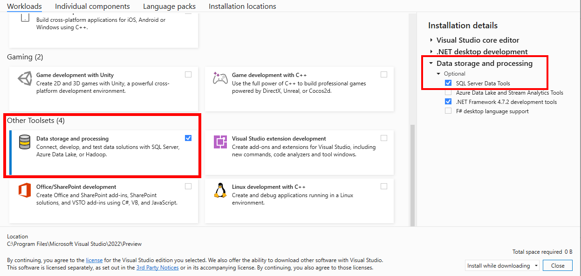
Software
Visual Studio (Community Edition)
Other toolsets
Data storage and processing

Slide 9

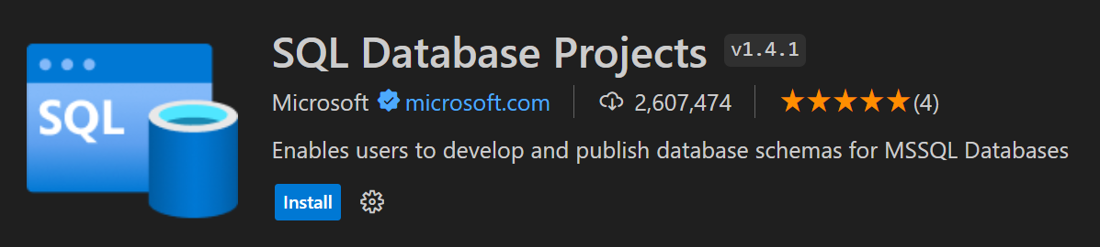
Software
Visual Studio Code: extension for SQL Database Projects

Slide 10
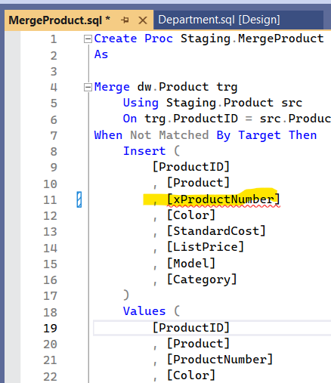
Visual Studio bonus value
Build project
Detects syntax errors and invalid references
Sanity check before attempting to deploy
DACPAC file generated

Slide 11
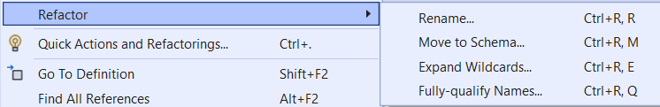
Visual Studio bonus value
Context menu
Refactor
Go To Definition
Find All References

Slide 12
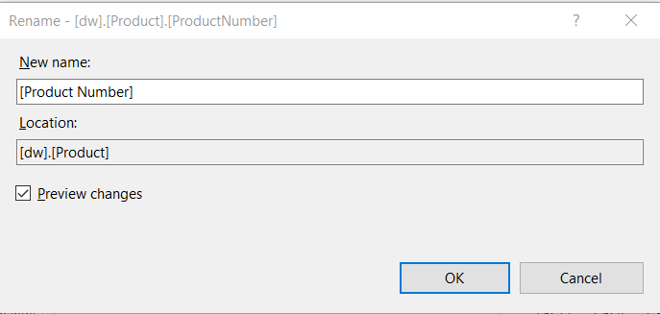
Visual Studio bonus value
Context menu
Refactor
Critical to avoiding data loss on deployment

Slide 13
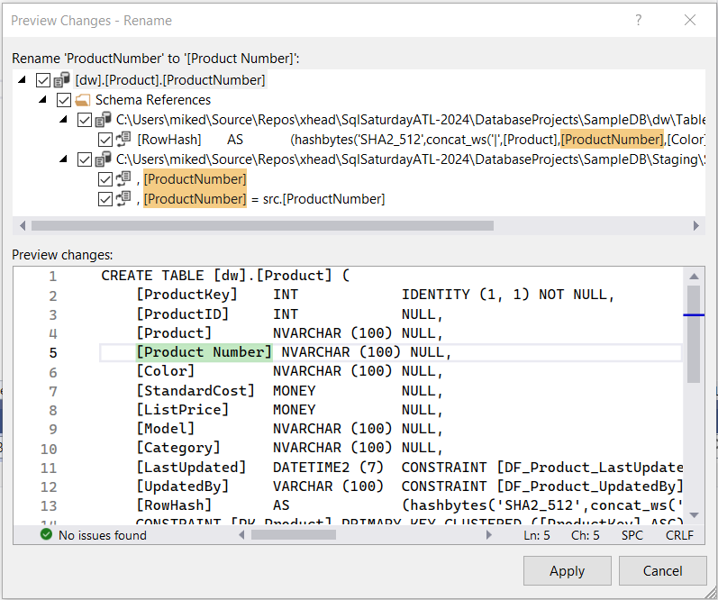
Visual Studio bonus value
Context menu
Refactor
Critical to avoiding data loss on deployment
Refactoring tracked in SampleDB.refactorlog

Slide 14
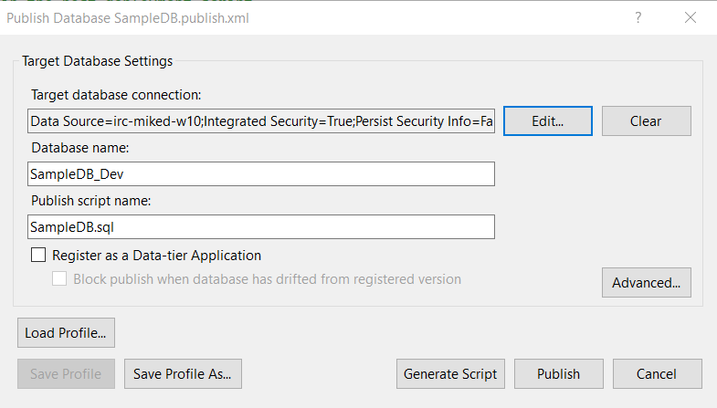
Publish from Visual Studio
Rt-click, Deploy
Create script
Publish directly
Publish profiles (*.publish.xml)
Critical settings in publish profile
Use Smart Defaults
Ignore column order

Slide 15
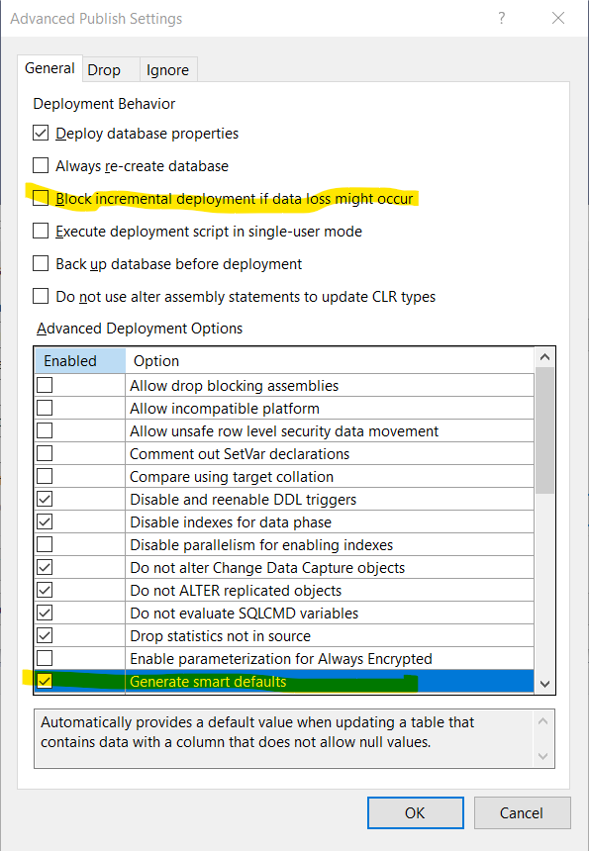
Publish from Visual Studio
Rt-click, Deploy
Create script
Publish directly
Publish profiles (*.publish.xml)
Critical settings in publish profile
Use Smart Defaults
Ignore column order

Slide 16
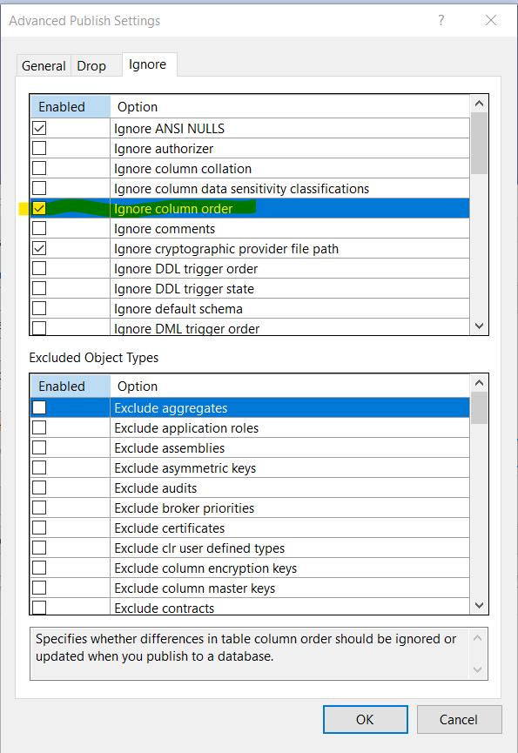
Publish from Visual Studio
Rt-click, Deploy
Create script
Publish directly
Publish profiles (*.publish.xml)
Critical settings in publish profile
Use Smart Defaults
Ignore column order

Slide 17
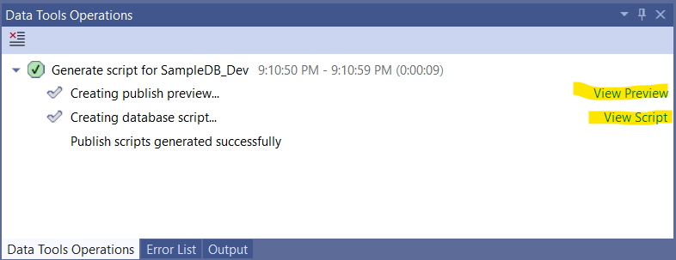
Publish from Visual Studio
Rt-click, Deploy
Create script
Publish directly
Preview contains summary of actions and potential warnings
Avoid table rebuilds

Slide 18
Publish Profile settings
Custom SQLCMD build variables
Deleting objects in target, not in project
Keep clean or don’t clobber ad hoc changes?
Separate development from administration where possible
Ignore users, role memberships

Slide 19
SQLPACKAGE.EXE
Command line utility for deploying DACPAC files to SQL database
Uses DACPAC file and publish.xml file
Command line options
Generate script
Deploy changes
Used by Azure DevOps deployment tasks or other CI/CD processes

Slide 20
Pre-/Post-deploy scripts
Only one per project
:r .\DefaultSecurity.sql
:r .\BackfillReferenceData.sql
:r .\Patch_2024-2-10.sql
Scripts must be idempotent
Run one or more times without affecting the desired outcome

Slide 21
SQLCMD syntax
:r – run file
:setVar – set variable
$(variables)

Slide 22
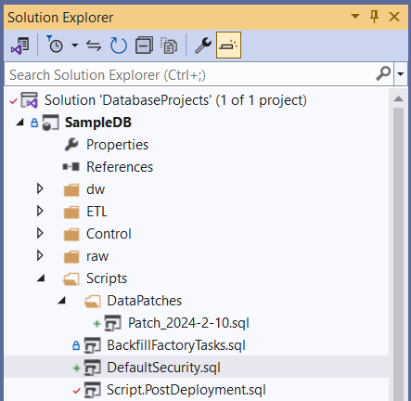
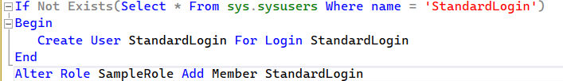
Default security

Slide 23
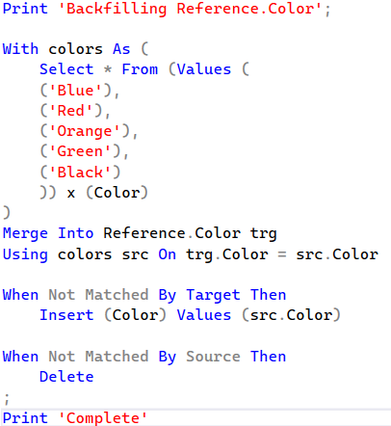
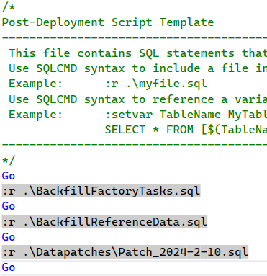
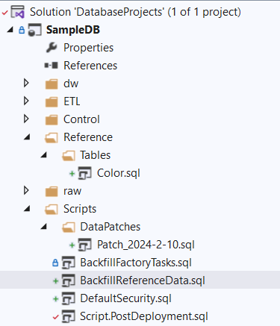
Backfilling Reference Data

Slide 24
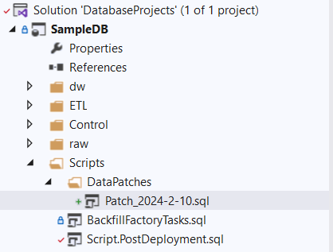
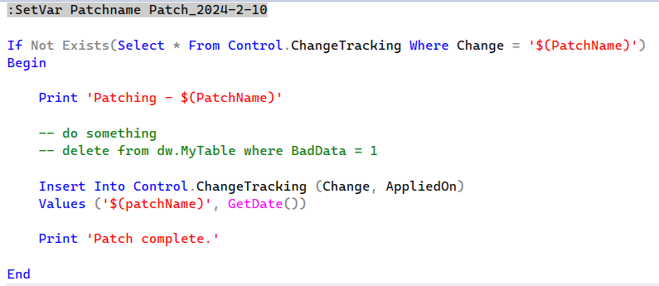
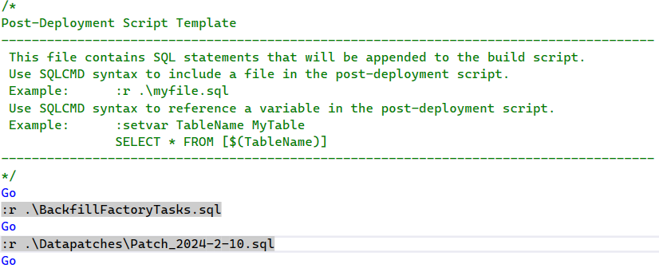
Executing Data Patches

Slide 25
Importing from an existing database
Databases *should* be self-contained
Often exposes errors/problems
Missing objects, bad names
Three-part and four-part names
Replace external references with CREATE SYNONYM and $(variables)

Slide 26
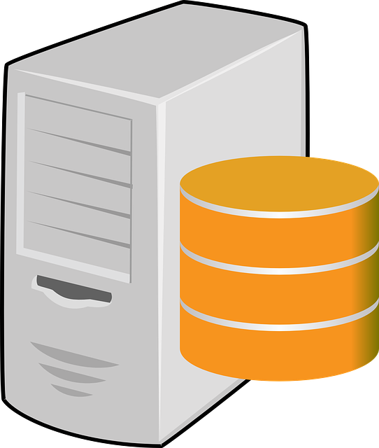
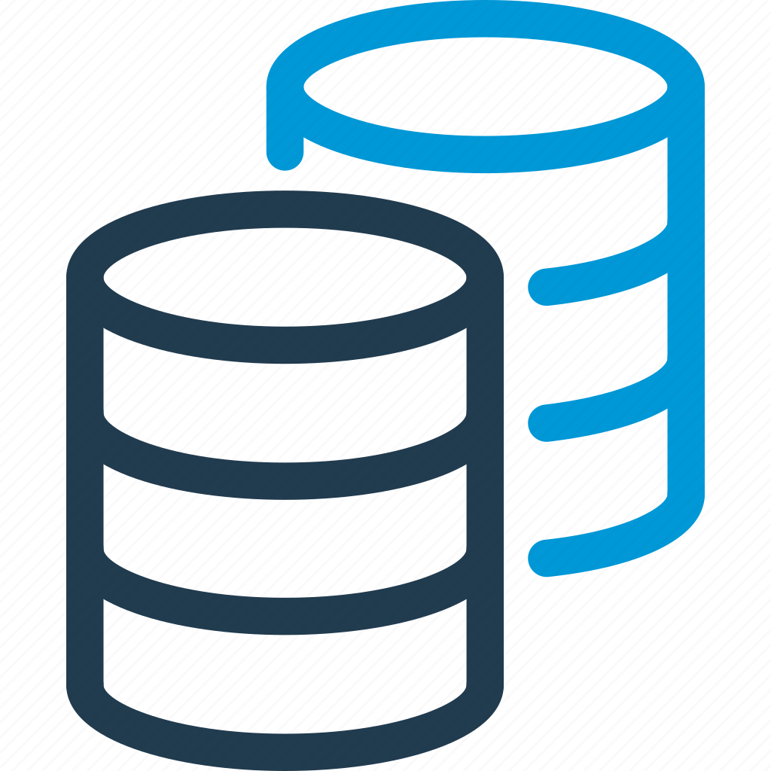

Database references
What is in or out of your control? What can you deploy?
System databases
master, msdb
Other database projects
DACPAC files (binary reference)
Target:
Different server, different database
Same server, different database
Same server, same database
Project B
Project A
Project B
Project A
Project A
Project B

Slide 27
Database reference scenarios
Cross-reference to another database outside of your control
Same or different server, different database (dependency)
CREATE SYNONYM to specific tables, views or sprocs
Deploy only our own objects in our own database
Schema compare on original database
Same server, same database (inheritance)
No synonyms necessary
Deploy our own objects in the referenced database
Don’t clobber other objects in the target database
Our own objects could get clobbered by another deployment

Slide 28
Database reference scenario – Unit Testing
Database project (SUT - system under test)
Unit test framework project contains framework objects (TDD)
Test database project
References database project under test and unit test framework project
Both references are “same server, same database”
Contains test objects (sprocs)
Deploy test project and execute unit tests in unit test environment or part of a build
SUT database and TDD framework objects get deployed
Execute unit tests for pass/fail
Deploy SUT normally in production environments
Clean deploy - no TDD or unit tests included

Slide 29
Using SQL Database Projects
With Visual Studio
SQL Server Data Tools
https://github.com/xhead/SqlSaturdayATL-2024
Mike Diehl, Miked@imaginet.Com
Practice Lead
Data Engineering and Business Intelligence
@xhead
/mikediehlsqlbi

